Slide 1

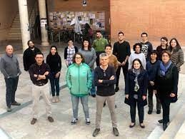
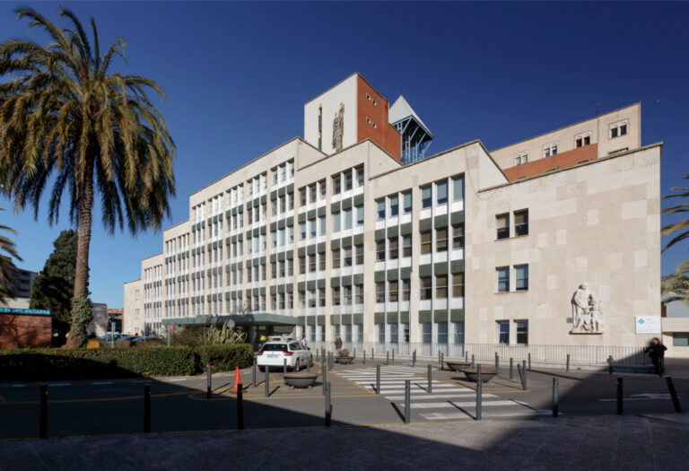



LOCATIONS
THESIS PROJECT TITTLE
Facultad Medicina i
Ciències de la Salut
Reus
Hospital Joan 23 de Tarragona
Name and Surname
Investigation Group I belong
OBJECTIVES
TECHNIQUES
1. To stablish a relationship between the protein X and the Y disease
2. To identify prognostic and predictive biomarkers of disease Z in response to W treatment.
3. ….
qPCR
WB
Cell culture (what cell lines)
ELISAs
Electronic microscopy
Patients (what diagnoses)
Clinical questionnaires
Biomarker determination
…

Slide 2


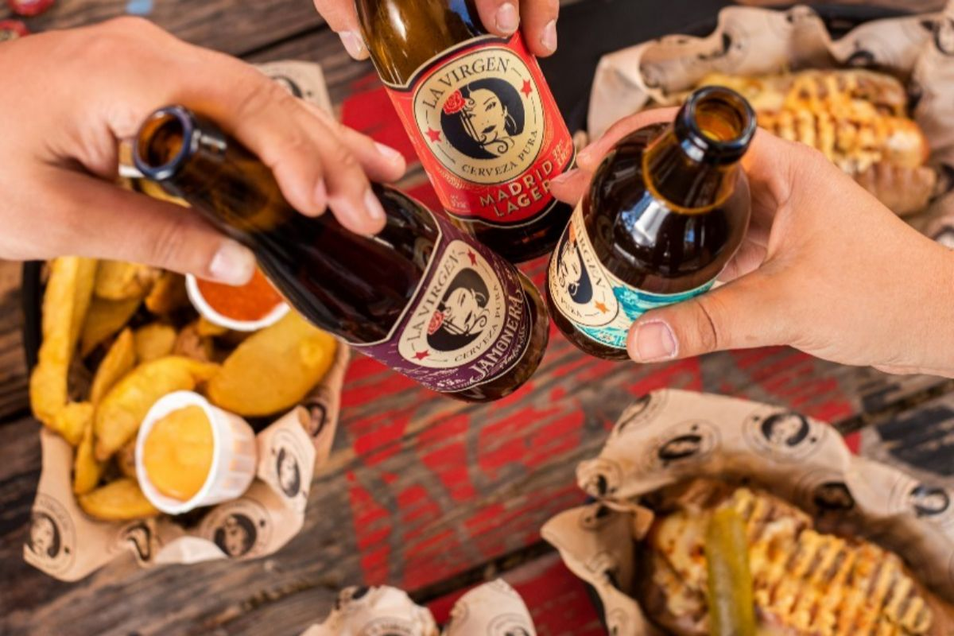




Name and Surname
Investigation Group I belong
Thesis project title
PICTURE
WHERE DO I LIVE
WHERE AM I FROM
WHAT I DO WHEN I’M NOT ON MY PHD
Reus
Valencia

